Slide 1
ENGLISH TENSES
sabaqd321@gmail.com

Slide 2
WHY, TENSES IMPORTANT
Each tense indicates the connection between two or more time periods or the exact time an activity occurred, which underlines the importance of English grammar tenses. They can be used to create different meanings from the same verbs and help to anchor the listener understand the meaning behind your story.

Slide 3
EVERYDAY LIFE
1)I have just reached home. 2)They have finished their project just now. 2)Present perfect tense is used for the past action having its effect in the present. If there is no effect in the present then simple past tense is used

Slide 4
Types Of Tense
There are three types of tenses in English grammar: Present Tense, Past Tense, and Future Tense.
Each Tense is further divided into four types: Indefinite Tense, Continuous Tense, Perfect Tense, and Perfect Continuous Tense

Slide 5
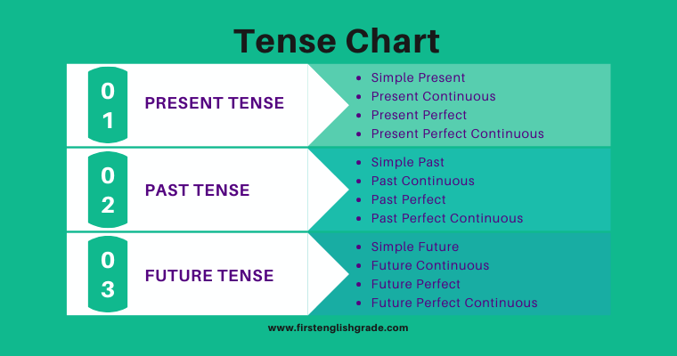

Slide 6
